Slide 1
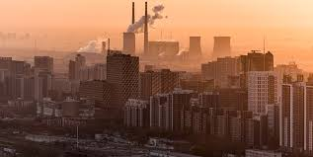




Whispers of Safety :
AIR QUALITY ANALYSIS
OF INDIA
BY-
Nikhil Anand
219310236
AIML – 5E
21.11.2023.

Slide 2
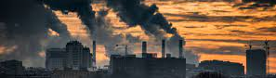


CONTENTS
01. Problem Statement and Introduction
02. Methodology
03. Flow Diagram
04. Result
04. Model Accuracy Scores
04. Conclusion

Slide 3





INTRODUCTION
PROBLEM STATEMENT
Air pollution is a pressing environmental concern globally, with India experiencing significant
challenges due to deteriorating air quality. This project endeavors to analyze air quality data
sourced from Kaggle to understand patterns, trends, and key factors influencing air pollution
levels across different regions in India.
The dataset, comprising diverse parameters such as so2, no2, rspm, spm levels, and more, was
subjected to comprehensive exploratory data analysis (EDA) to unveil insights into pollutant
concentrations and their geographical variations. The data underwent rigorous preprocessing,
including handling missing values and feature engineering, to ensure the accuracy and reliability of subsequent analyses. Then utilizing machine learning methodologies such as regression and
classification models, this study aimed to predict air quality levels and identify potential
interventions to mitigate pollution. The models were evaluated based on established metrics,
providing an assessment of their performance and predictive capabilities.
The outcomes of this analysis offer valuable insights into India's air quality landscape, shedding
light on key factors influencing pollution levels. The project serves as a foundational exploration, laying groundwork for further investigations and policy considerations to mitigate air pollution’s
impact on public health and the environment.
Analyzing India's air quality data,
this project aims to predict
pollutant concentrations and
classify air quality levels using
machine learning techniques.
The goal is to develop accurate
models that can forecast
pollutant levels and categorize
air quality, addressing the
pressing challenge of escalating
air pollution across diverse
regions in India.
Tech Stack-

Slide 4
Data Collection & Integration
Utilizing the INAI provided 1.8 million real-world events from 130 vehicles.
Additionally gathering supplementary data through APIs and internet sources.
METHODOLOGY
Data Prepossessing
Process and clean the collected data, addressing inconsistencies, missing values, and outliers.
Exploratory Data Analysis (EDA) & Feature Engineering
EDA to uncover patterns, correlations, and anomalies within the merged dataset.
Feature Engineering to create new features from the integrated data.
Advanced Analysis
Predictive models using ML algorithms to forecast potential accident-prone zones or high-risk driving behaviors based on the integrated dataset. And employing clustering algorithms to categorize driving patterns and classify high-risk scenarios for proactive intervention.
Visualization & Reporting
Utilize visualizations such as heatmaps, geographical plots, and trend charts to represent insights derived from the integrated dataset. And summarize the findings, insights, and proposed solutions in a clear, structured research report.

Slide 5

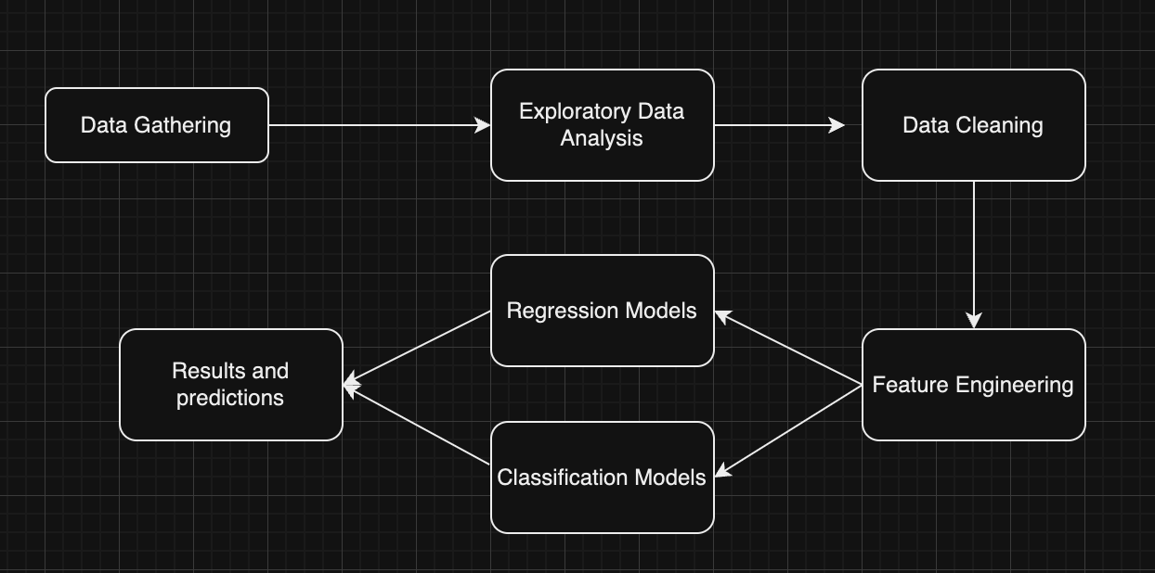
FLOW DIAGRAM

Slide 6
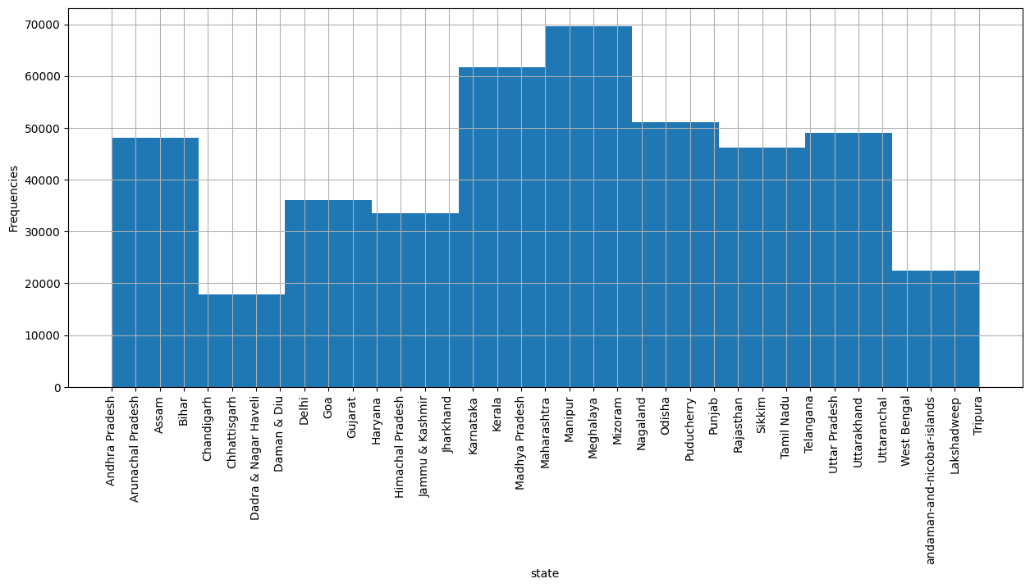
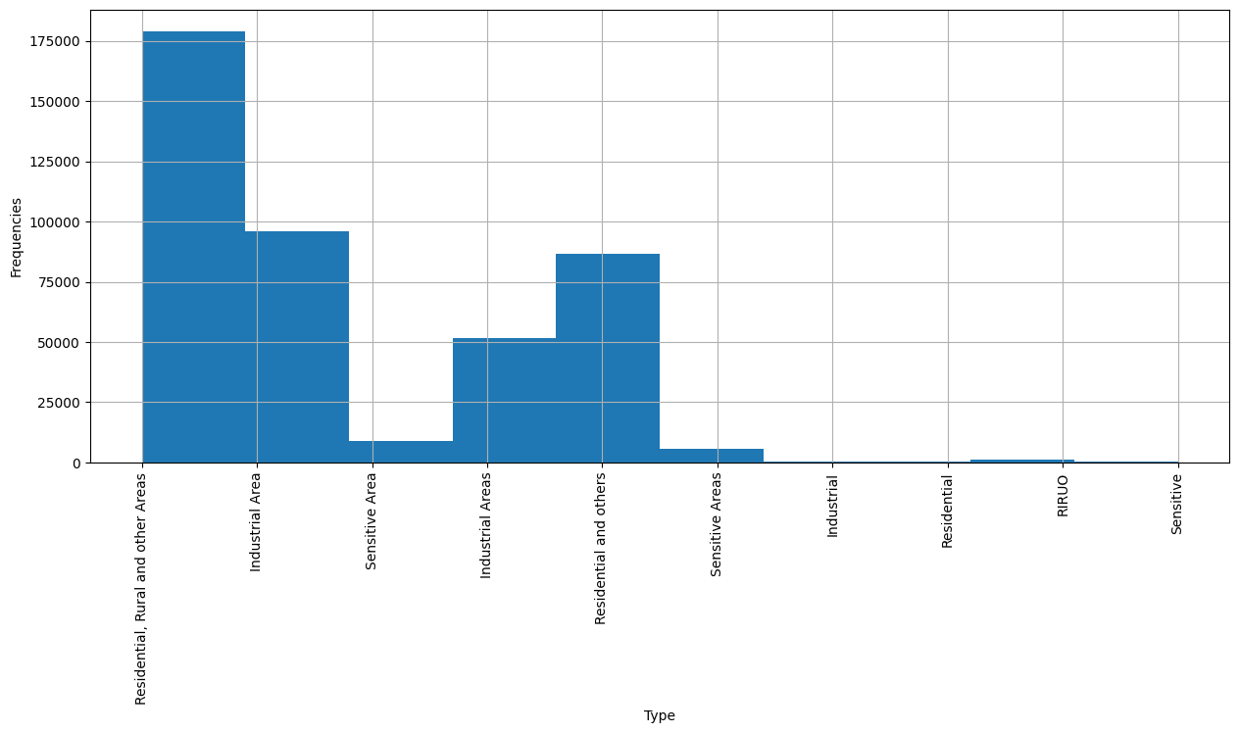
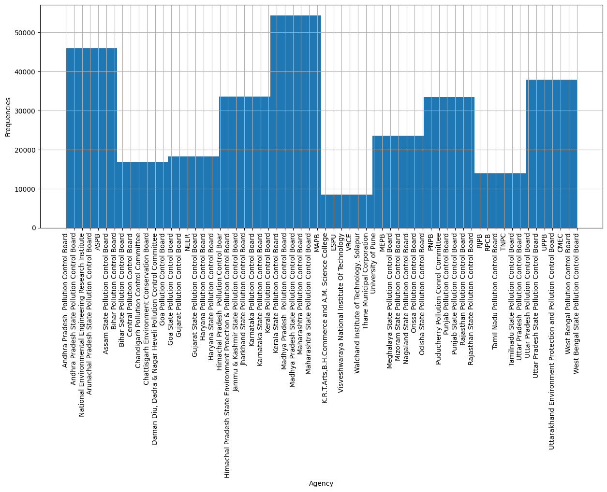
RESULT

Slide 7
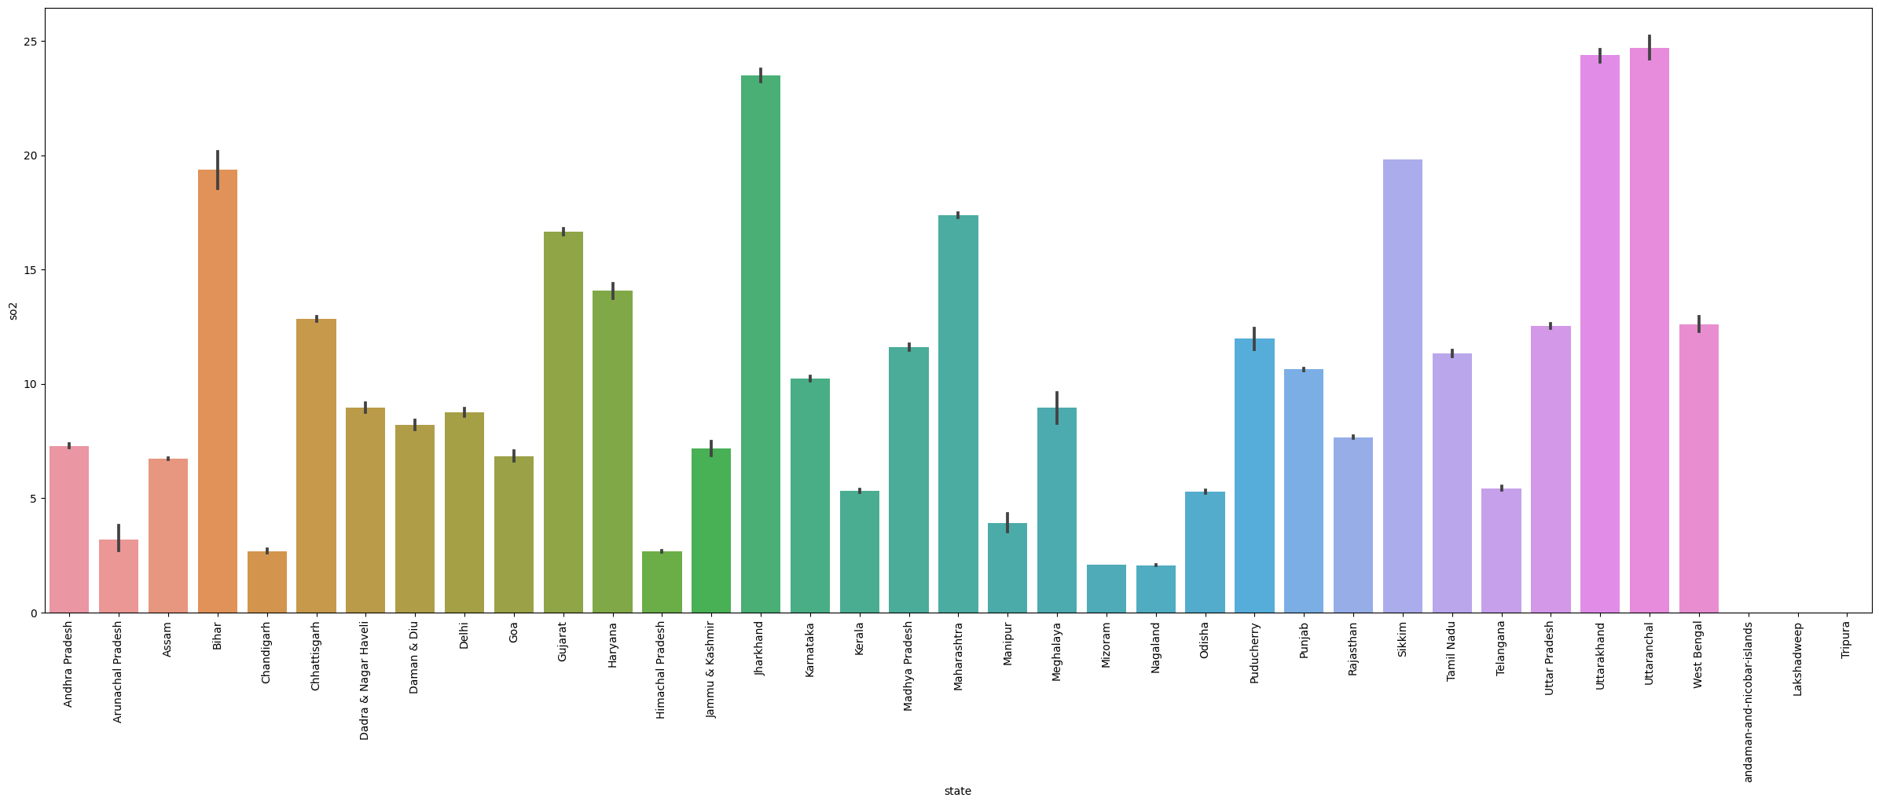
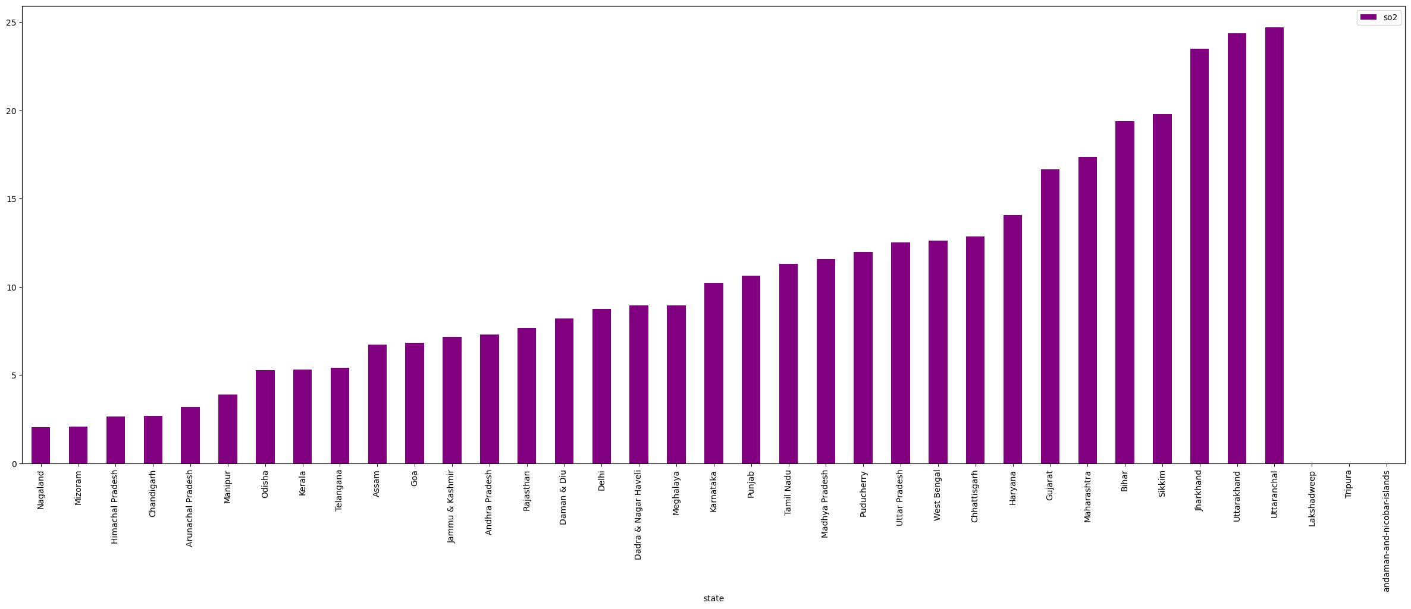
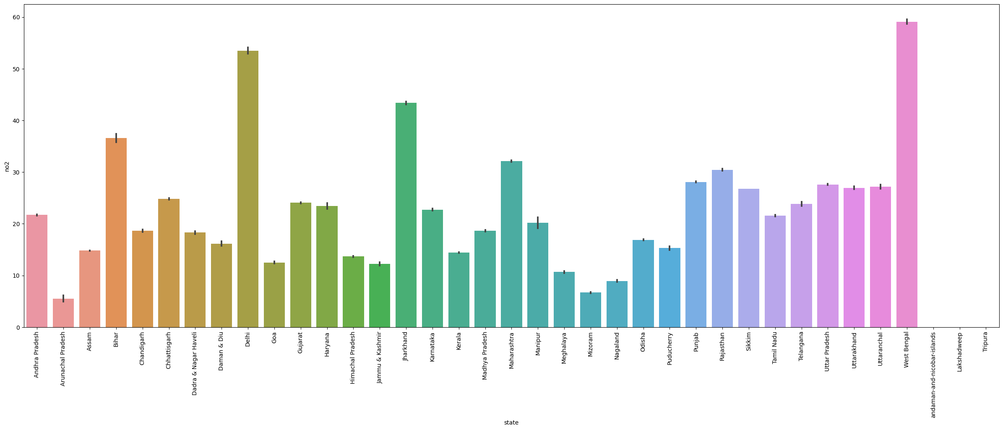
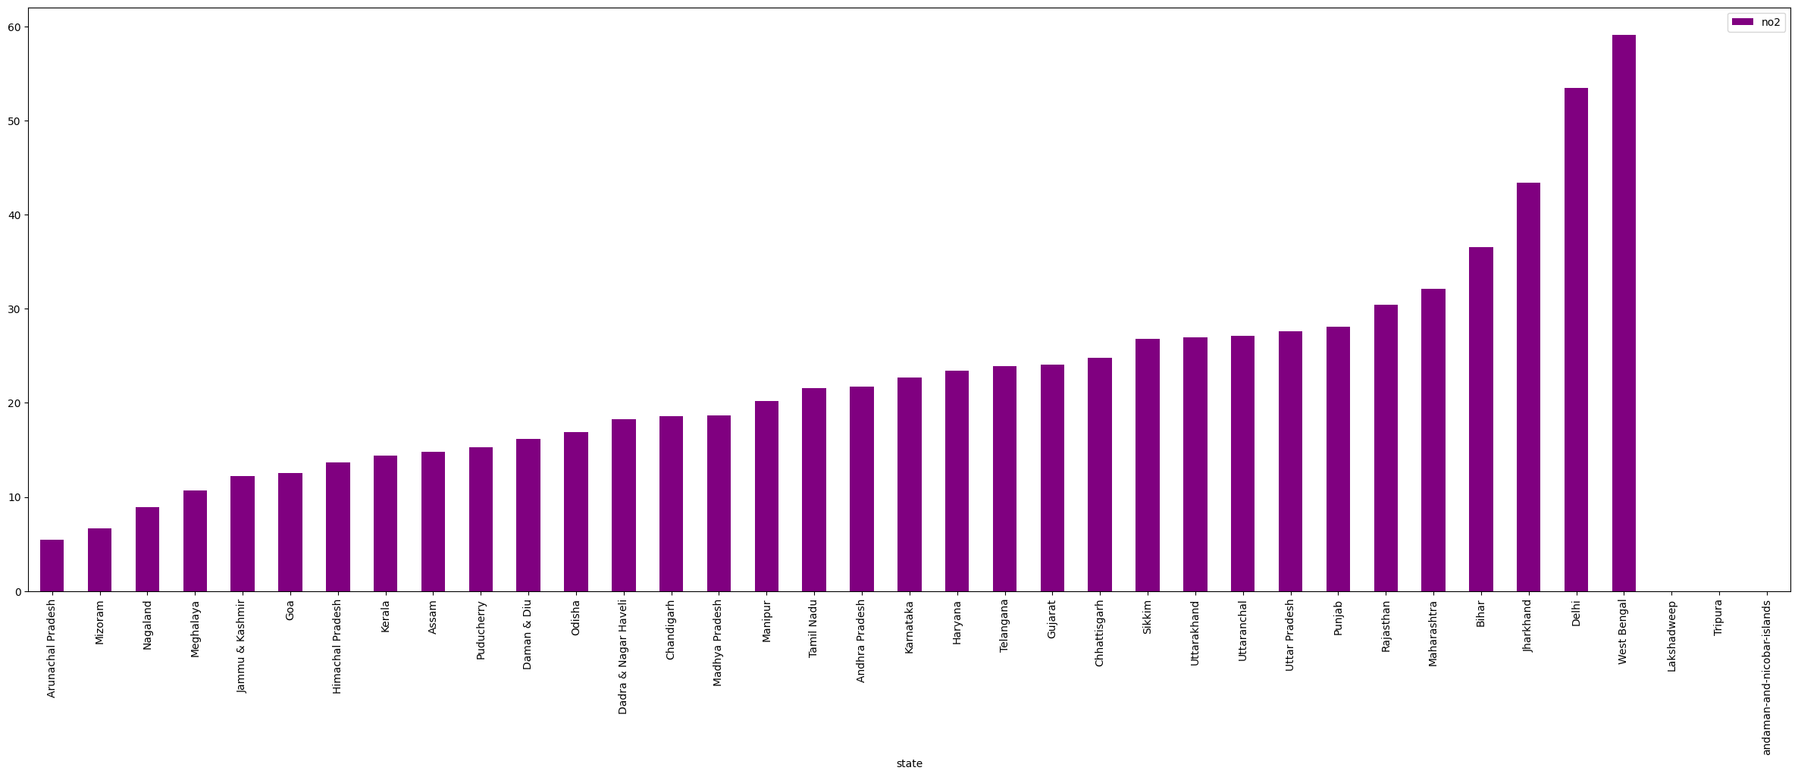
RESULT

Slide 8
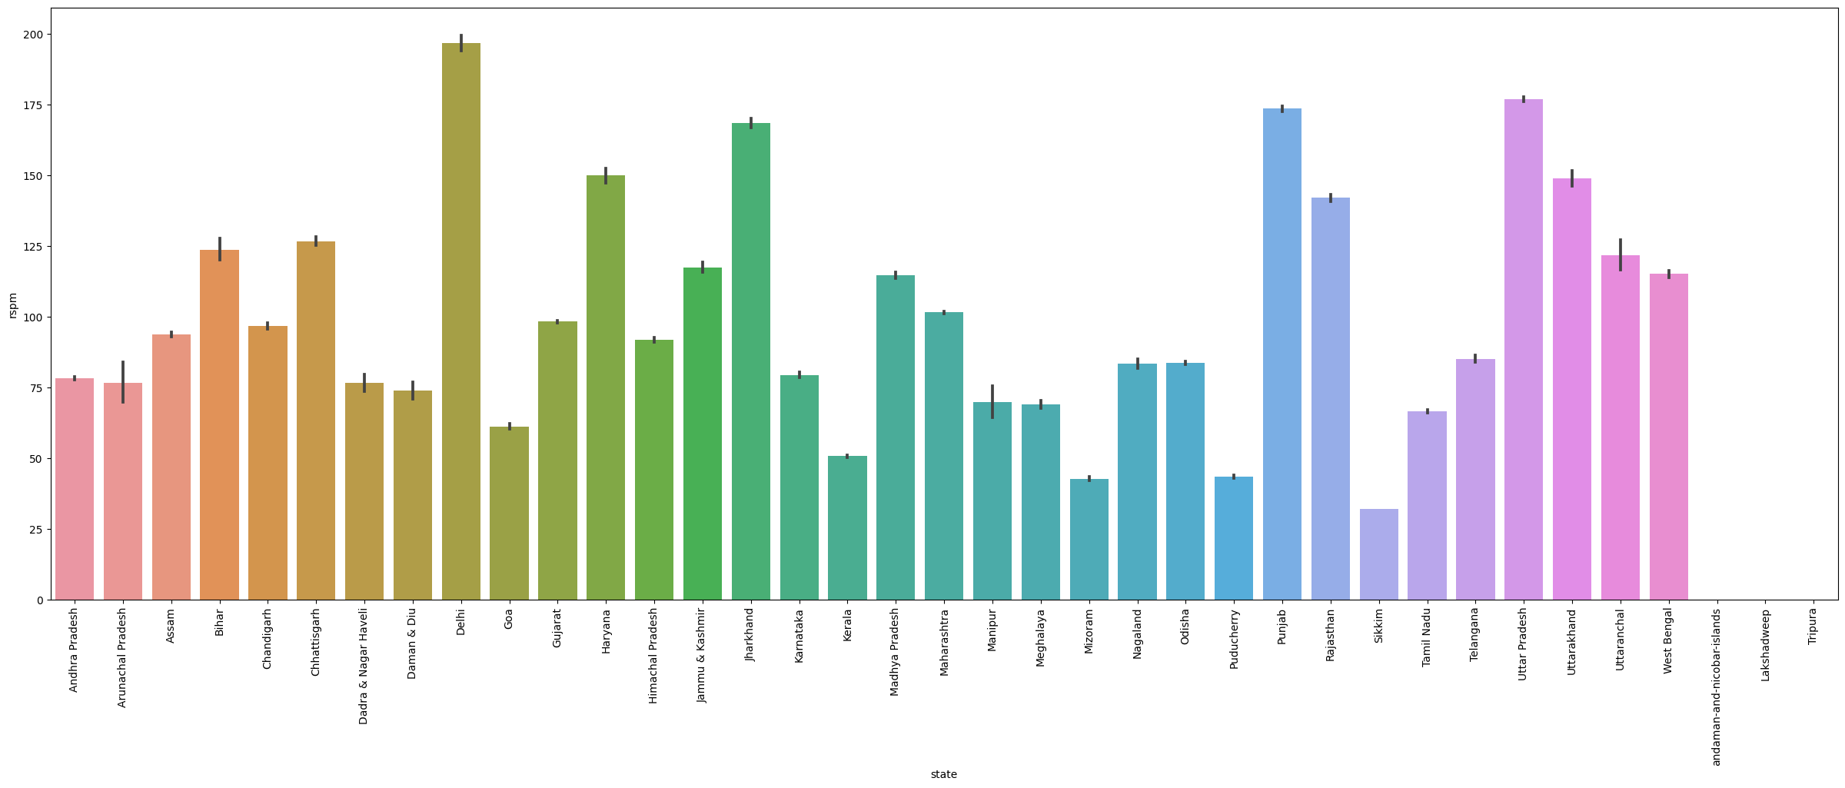
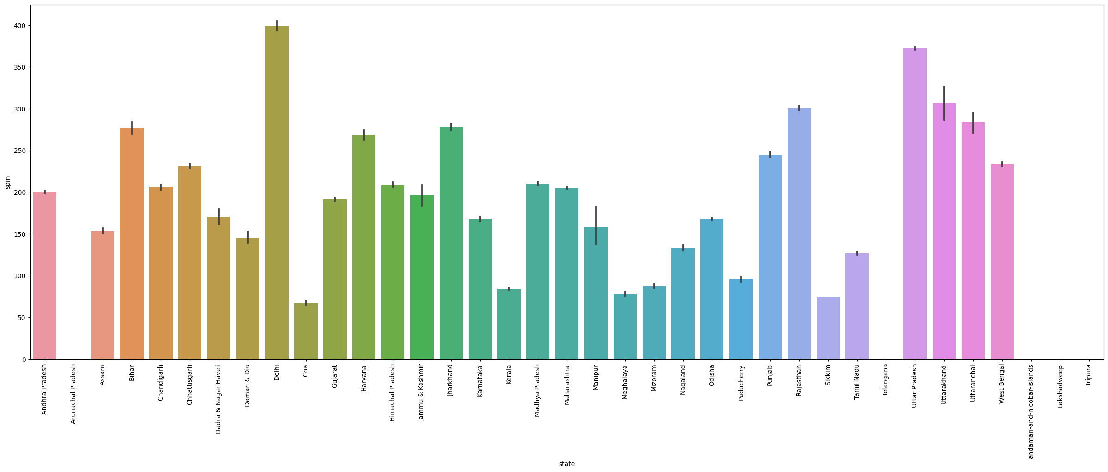
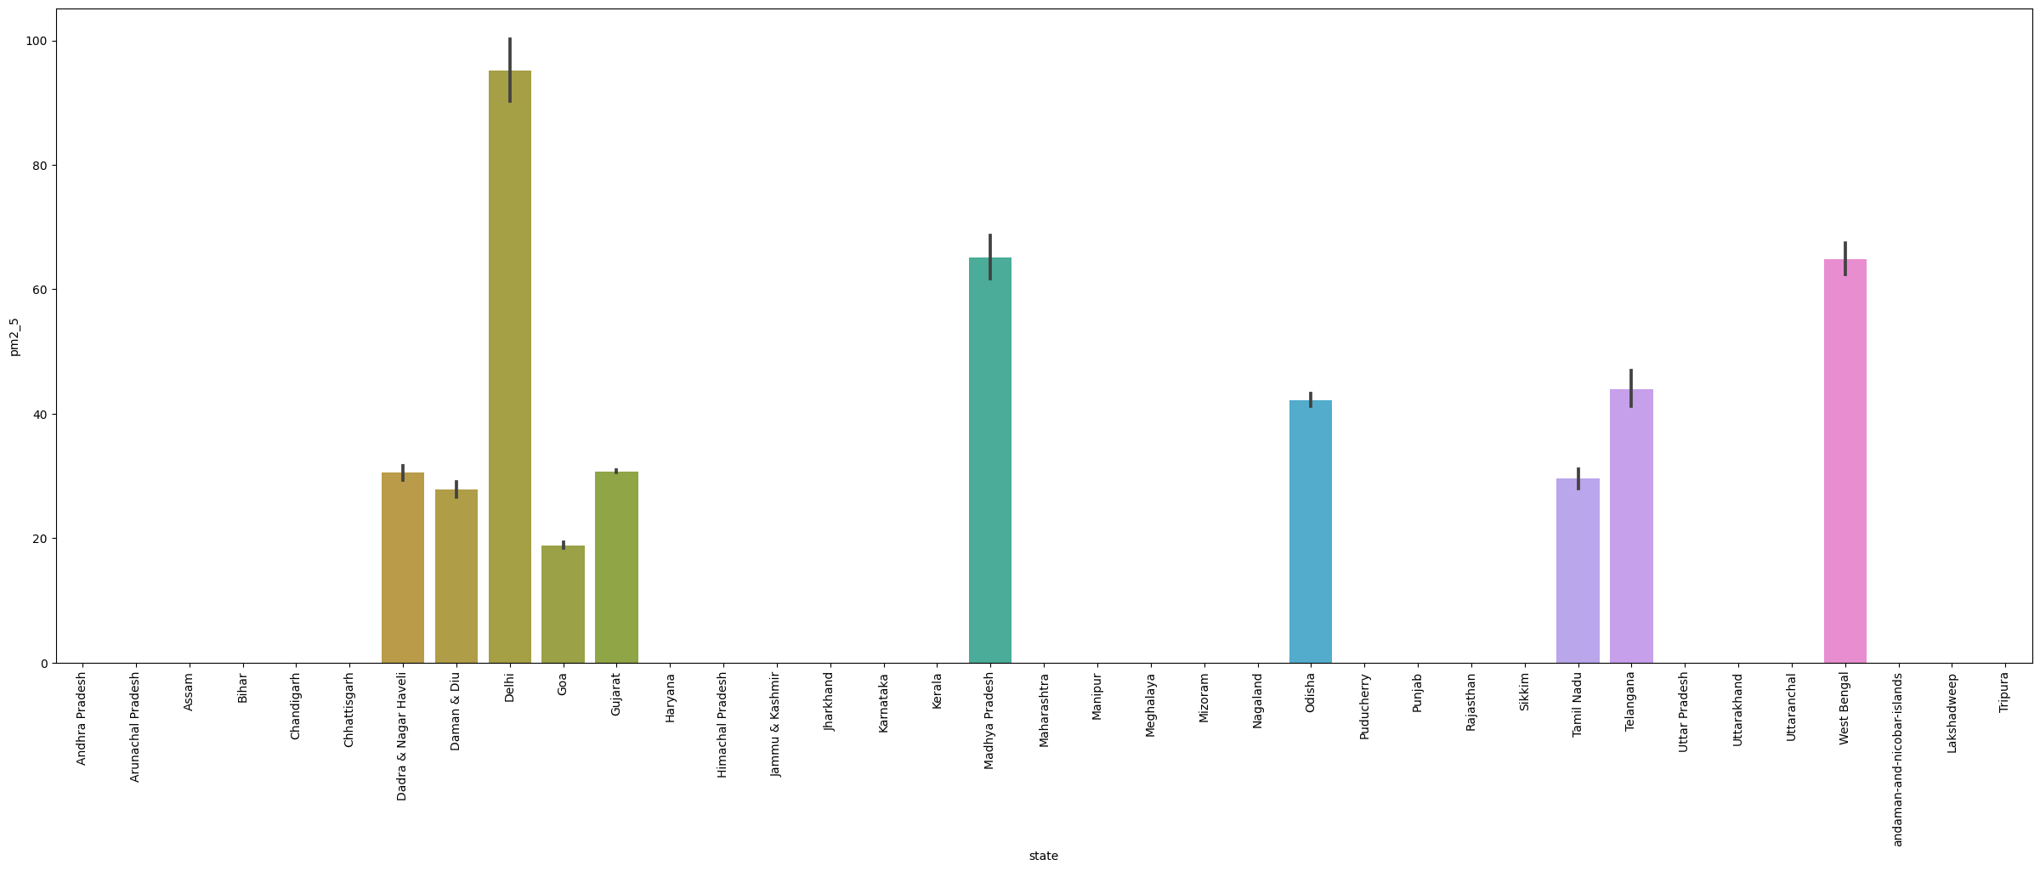
RESULT

Slide 9
RESULT
Insights-
1
This visualization shows the name of the state having higher so2 levels in the air which is Uttaranchal followed by Uttarakhand
2
West Bengal has a higher no2 level compared to other states
3
Delhi has higher rspm level compared to other states
4
Delhi has higher spm level compared to other states
5
Delhi has higher pm2_5 level compared to other states

Slide 10
Regression
Classification
Linear Regression:
Mean Squared Error on Training Data:
185.3468910681126
Mean Squared Error on Test Data:
183.59529726105222
Decision Tree Regressor:
Mean Squared Error for Training Data:
5.308906076453251e-26
Mean Squared Error for Test Data:
1.9957715887297105
Random Forest Regressor:
Mean Squared Error on Training Data :
0.17079496770568375
Mean Squared Error on Test Data :
1.5451528858858707
Deep Learning:
Mean Squared Error on Training Data:
0.7069955468177795
Mean Squared Error on Test Data:
0.5087568163871765
Logistic Regression:
Model accuracy on train is: 0.718456767634462
Model accuracy on test is: 0.7230719801718896
--------------------------------------------------
KappaScore is: 0.5750393534941016
Decision Tree Classifier:
Model accuracy on train is: 1.0
Model accuracy on test is: 0.9998508301873802
--------------------------------------------------
KappaScore is: 0.9997781298249673
Random Forest Classifier:
Model accuracy on train is: 1.0
Model accuracy on test is: 0.9997934571825264
--------------------------------------------------
KappaScore is: 0.9996927973107813
K-Nearest Neighbour:
Model accuracy on train is: 0.9983705926395539
Model accuracy on test is: 0.9969133323388679
--------------------------------------------------
KappaScore is: 0.9954082566416549
Deep Learning:
Model accuracy on train: 0.9970510021715869
Model accuracy on test: 0.9966953149204236
--------------------------------------------------
KappaScore on test: 0.9950837452960384
Model Accuracy Scores

Slide 11
In conclusion, the analysis of air quality data revealed insightful patterns and notable observations across various parameters. Visualizations presented the
distribution of states, types, and agencies within the dataset, providing a
comprehensive overview. Uttaranchal and Uttarakhand showcased higher SO2 levels, while West Bengal stood out for elevated NO2 levels among states. Delhi emerged with higher RSPM, SPM, and PM2.5 levels, highlighting distinctive
pollution concerns. The regression models, including Linear Regression,
Decision Tree, Random Forest, and Deep Learning, showcased varying degrees of predictive accuracy, with the Decision Tree demonstrating exceptional
performance. Similarly, classification models, encompassing Logistic
Regression, Decision Tree Classifier, Random Forest Classifier, K-Nearest
Neighbour, and Deep Learning, exhibited strong accuracy, emphasizing robust prediction capabilities. The high accuracy rates, particularly in Decision Tree
and Random Forest classifiers, underscore the potential of these models in
accurately categorizing air quality. These findings collectively emphasize the
significance of machine learning techniques in comprehensively analyzing and predicting air quality indicators, providing valuable insights crucial for informed decision-making and policy interventions aimed at improving air quality
standards.
Conclusion

Slide 12
Thanks !

